Slide 1
Team H
Sprint #4

Slide 2
Stories
6 out of 7 stories commited were done

Slide 3
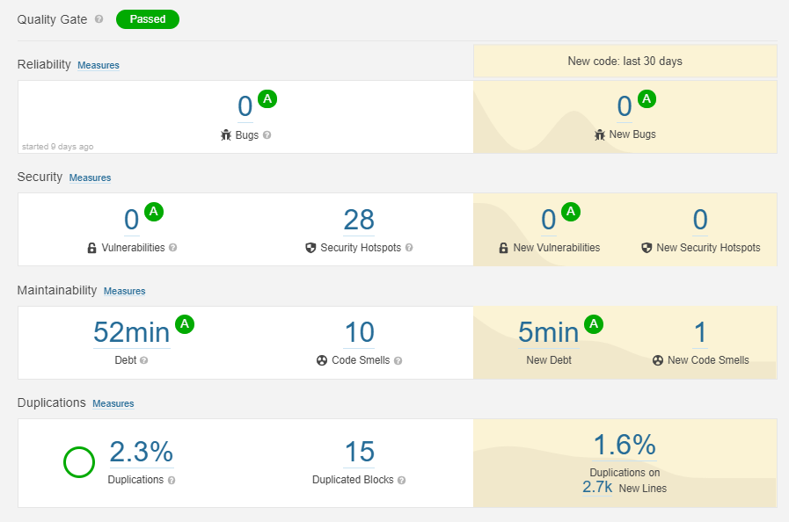

Slide 4
Story #22
As a parent I want to see the final grades of the term.

Slide 5
Story #23
As a parent I want to book a meeting with a teacher so that I can get feedback on my child’s behavior and performance.

Slide 6
Story #24
As an administrative officer I want to manage the teachers master data.

Slide 7
Story #25
As a parent I want to see the timetables of the class.

Slide 8
Story #26
As a parent I want to know the daily lecture topics so that I am informed about the progress of the lectures.

Slide 9
Story #28
As a teacher I want to check the timetables of the classes.

Slide 10
Story #27 (not done)
As an administrative officer I want to build the timetable of classes so that I can check all constraints are satisfied.

